Slide 1
Applied Data Science מדע נתונים יישומי
Dr. Omri Allouche
2017

Slide 2
Platform Setup @ HOME
Install Anaconda on your laptop
Open the Anaconda Prompt
Clone the course Git repo to your local machine $ git clone github.com/omriallouche/applied-data-science
Open the Jupyter Notebook server $ jupyter notebook
Familiarize yourself with Jupyter Notebooks. Get to know:
Keyboard Shortcuts
Markdown syntax
Follow Scikit Learn’s basic Introduction to Machine Learning (make sure you run the code yourself, using Jupyter Notebook!)

Slide 3
Homework – part 1
Watch 3 Project Videos submitted for Harvard’s CS109 (search YouTube for “CS109”). Email omri.allouche@gmail.com with a list of terms from each video, each marked with: 1 – don’t know anything about it 2 – have a vague idea what it is 3 – I know it pretty well
Complete & review the Exercises Jupyter Notebooks for Python, Numpy

Slide 4
Homework – part 2
Install an RSS feed app on your mobile phone (I recommend Feedly), and subscribe to the RSS feed of Analytics Vidhya
Subscribe to the weekly newsletter of Data Machina
Sign up to meetup.com and join a few groups related to data science
Read "A Few Useful Things to Know about Machine Learning“
Watch “Talk Data to Me: Data Visualization Best Practices”

Slide 5
Python Crash Course - Review
Review in class of a Jupyter Notebook.

Slide 6
recommended materials

Slide 7
Python & DS Online Courses
Google’s Python Class - https://developers.google.com/edu/python/
DataCamp’s Interactive Tutorials - https://www.datacamp.com/courses/intro-to-python-for-data-science
EdX - https://www.edx.org/course/introduction-python-data-science-microsoft-dat208x-4#!
https://classroom.udacity.com/courses/ud120/lessons/2410328539/concepts/24185385370923#
CodeAcademy - https://www.codecademy.com/learn/python
https://www.udacity.com/course/intro-to-descriptive-statistics--ud827

Slide 8
Reading
An elaborate guide to Python with examples
https://github.com/jakevdp/PythonDataScienceHandbook
http://www3.canisius.edu/~yany/python/Python4DataAnalysis.pdf
https://datajobs.com/what-is-data-science

Slide 9
git & github
https://www.dataquest.io/course/git-and-vcs
Data School’s “Version control with Git and GitHub” YouTube Playlist -https://www.youtube.com/playlist?list=PL5-da3qGB5IBLMp7LtN8Nc3Efd4hJq0kD
Guide: http://www.dataschool.io/simple-guide-to-forks-in-github-and-git/
https://help.github.com/articles/fork-a-repo/
https://www.atlassian.com/git/tutorials/learn-git-with-bitbucket-cloud

Slide 10
Numpy – scientific computing
Review in class of a Jupyter Notebook.

Slide 11
pandas – Data Structures & Data Analysis. “Excel” in python
Review in class of a Jupyter Notebook.

Slide 12
Data visualization – matplotlib, seaborn, bokeh
Review in class of a Jupyter Notebook.

Slide 13
data visualization
Know your audience
Tell a story
Answer the “So what?” question. Have a specific message
Choose the right visualization
Keep it simple. Less is more

Slide 14
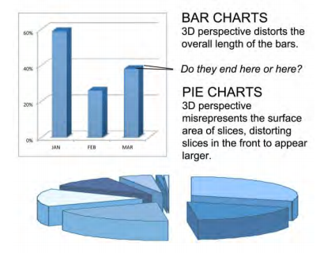
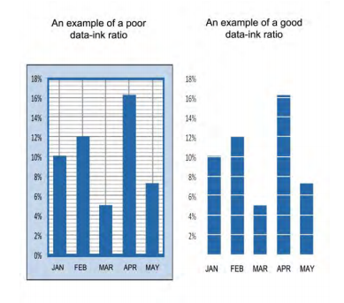
Maximize the data-to-ink ratio
Use the 5 seconds rule
Prefer 2D over 3D
Prefer grayscale over color

Slide 15
You're Learning a New Language
Immerse yourself in the new language
Read. A lot
Read. In English
Don’t be intimidated if you don’t understand everything, or even most of the things
Learn how you learn, and use it
There are great video courses & lectures online (list follows)
Weekly Meetups are held in Israel
Many books & blog articles, for all levels
Podcasts
Kaggle competitions

Slide 16
You're Learning a New Language
If you can't understand a concept from a specific source, try finding another one
Find a partner
Learn like a child. Experiment, and make mistakes
Learn a bit every day
Keep notes of what you don't know (or better yet, use the Spaced Repetition method)

